Slide 1
509 Funding Sheet Calculations

Slide 2
Overview of Content Covered:
509 Funding Sheets Overview
Minutes (Seat Time)
Division 1
Division 2
Have more questions? Be sure to contact DACCTE using the contact information on the last slide.

Slide 3
509 Funding Sheets Overview
509 funding calculation sheets have the Division 1 and 2 monies listed on it that are allocated to each school and are also broken down by program.
Sheets are provided to school administrators and teachers during the DACCTE school visits. Funding sheets are also provided upon request.
It is helpful, but not necessary to review the “State Funding Basics” PowerPoint prior to viewing this one. In the following slides I will break down the 509-funding information in greater detail.

Slide 4
Minutes (Seat Time)
Each year every school must complete the “Unit Count”. This determines the number of students enrolled in a program.
Unit Count is reported to the Delaware Department of Education and totals are calculated for “minutes”.
The minutes are separated into Division 1 and Division 2.
Division 1 is for Staffing.
Division 2 is separated in Energy Costs and Other Supplies, Materials, and Equipment.

Slide 5
Division 1
Division 1 funds are totaled using the Unit Count and reported for each course, etc. that is taught.
This number is added across the whole school for every CTE course, and a school arrives at a number of CTE staffing units allotted for the entire school.
For example- A school that generates 3 units in agriculture and 3 units in business will combine for a total of 6 units for the school. This doesn’t mean that there are 6 CTE teachers at the school. There may be 5 teachers and the 6th unit is being used by the District in another way. This is acceptable. Don’t be alarmed.
Notes:
The districts can use those units however they would like. There are no state laws in affect that say that the CTE units must be used for CTE staff. Very rarely will a district will use all of the cte units for actual cte teachers

Slide 6
Division 2 - Other Supplies, Material, and Equipment
If you are looking at your funding sheet, pay no attention to the Division 2- Energy costs. You can’t use it to buy supplies, etc. This money is used to pay the light bill, heating, cooling, etc.
Once all Division 2 units for the school are added together, we get a total number for the entire school. (This is also broken down by program)
For example- Those 3 Agriculture (Division 1 units) are producing 8.3 Division 2 units. We take the 8.3 and multiply that by $2925 which equals $24,277.50. This is 100% of the funds the Agriculture program generates for supplies. Each CTE program at the school would be calculated in the same way and a total for the school would be arrived at.
Notes:
Point 1 – forget about it that keeps your lights on
Bottom point – example to go through

Slide 7
Division 2 - Other Supplies, Material, and Equipment
Using the previous slides example of a total of $24,277.50, the State Law allows for 10% of that amount to go toward Administrative purposes, discretion, etc. However, 90% of the funds should be going to the program that generates the funding.
This is where many people get confused about the 90%, ideally in our example, Agriculture would get 90% of the $24,277.50. However, the Administration of the school has the discretion to use that funding for other CTE program areas. This means that if the Agriculture department only needed/used $18,000 , the remainder of what the Agriculture department generated could be spent in another CTE area at the school or vice versa. 509 funding is to be spent on CTE programs only! This is the student supply money for projects, etc.
Notes:
Remember the money is a bucket – we need to share. Have a conversation with your admin (it might be spent within the school within another CTE pathway)

Slide 8
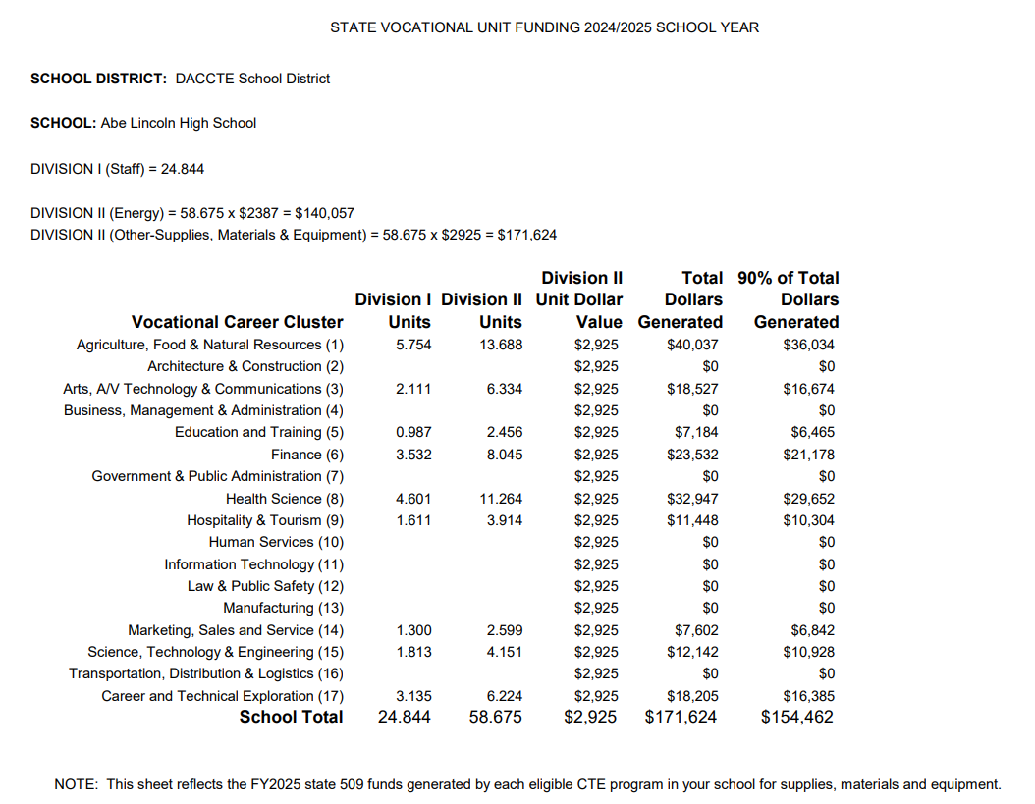
EXAMPLE FUNDING SHEET

Slide 9
Contact DACCTE
Mailing Address | 240 N. James Street #201, Wilmington, DE 19804
Website | www.daccte.delaware.gov
Phone | 302-995-8592
Fax | 302-995-8594
Executive Director Email | christopher.stahl@delaware.gov
CTE Specialist Email | caitlin.rozell@delaware.gov
Administrative Assistant Email | ann.breeding@delaware.gov

