Slide 1
Basics of DACCTE
Delaware Advisory Council on Career and Technical Education

Slide 2
Overview of Content Covered:
Who is DACCTE?
Why does DACCTE exist?
DACCTE Mission
How does DACCTE complete it’s mission?
Contact DACCTE
Moving Forward
Have more questions? Be sure to contact DACCTE using the contact information on the contact slide.

Slide 3
Who is DACCTE?
Delaware Advisory Council on Career and Technical Education (DACCTE)
DACCTE is composed of individuals appointed by the Governor from both the private and public sectors throughout the State.
Membership includes representatives from - business, industry, labor/trade organizations, National Guard, and educators representing secondary, post-secondary, career guidance/counseling, and special needs.
DACCTE is not the Department of Education (DOE). We work and collaborate with DOE; however, we are an independent agency.
Executive Director- Christopher Stahl
CTE Specialist – Caitlin Rozell
Administrative Assistant- Ann Breeding

Slide 4
Why does DACCTE exist?
DACCTE was developed in response to Carl D. Perkins Funding legislation in 1969.
Delaware State Code Title 14, Part V, Chapter 86 specifically addresses the Purpose and Functions of the Delaware Advisory Council on Career and Technical Education.
DACCTE is an advocate for strong CTE programs in our State!

Slide 5
What is the mission of DACCTE?
The mission of DACCTE is to strengthen and enhance the Career and Technical Education (CTE) delivery system and to assist the State in providing quality programs and expanded opportunities for all citizens.
The Council monitors CTE programs and services to ensure that established state and federal services are being met.
The Council also makes policy recommendations to the Governor, General Assembly, Department of Education and State Board of Education pertaining to career and technical education in the State.

Slide 6
How does DACCTE complete its mission?
Recommending policies to strengthen CTE and school-to-career initiatives.
Monitoring CTE programs and services.
Providing technical assistance to all stakeholders to enhance and improve the CTE delivery system.
Analyze/report on the distribution/availability of funds for CTE programs.
Advise policymakers on CTE issues relating to the development of the State plan required for federal funding.
Promote coordination, collaboration, and effective partnerships among business, industry, education programs.
Disseminate relevant career info to all stakeholders within the State.

Slide 7
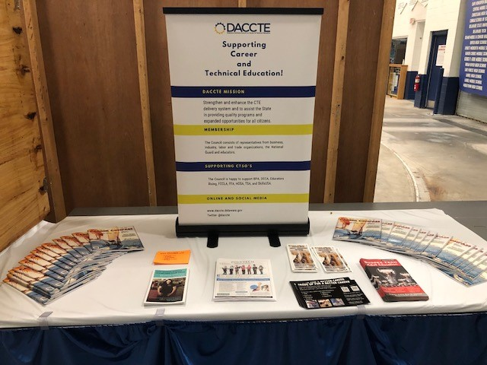
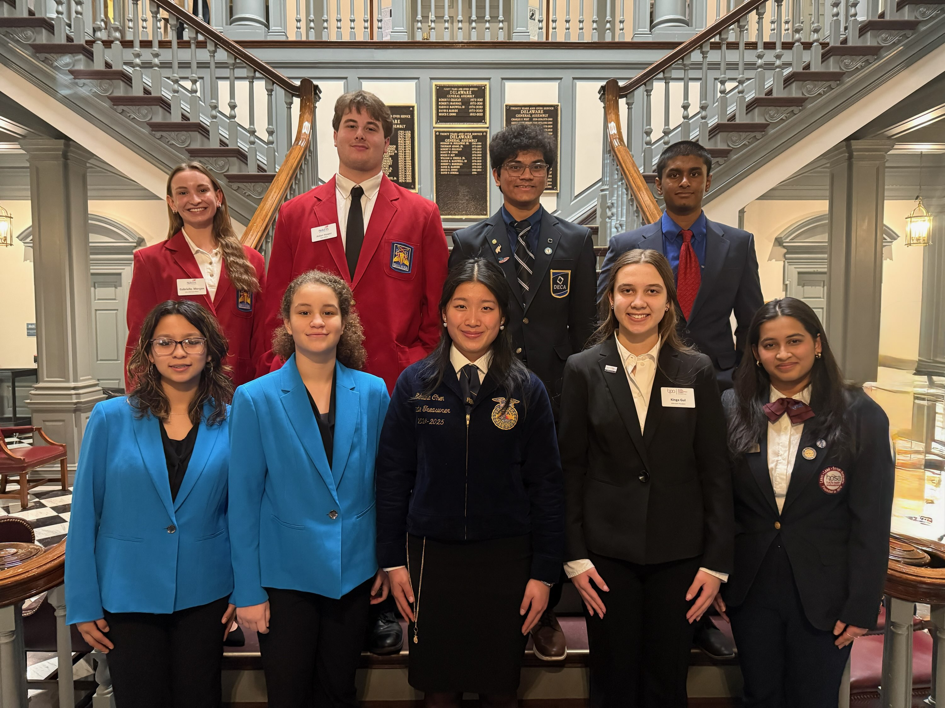
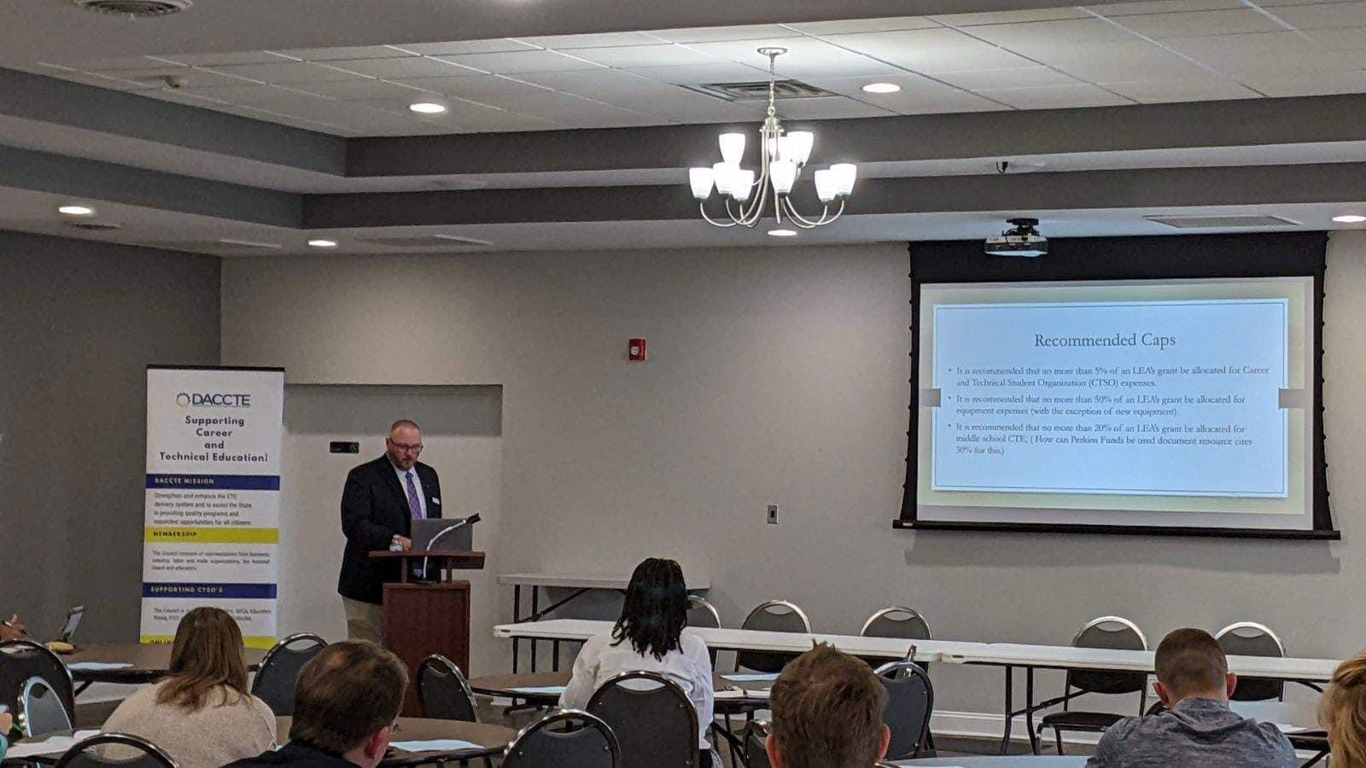
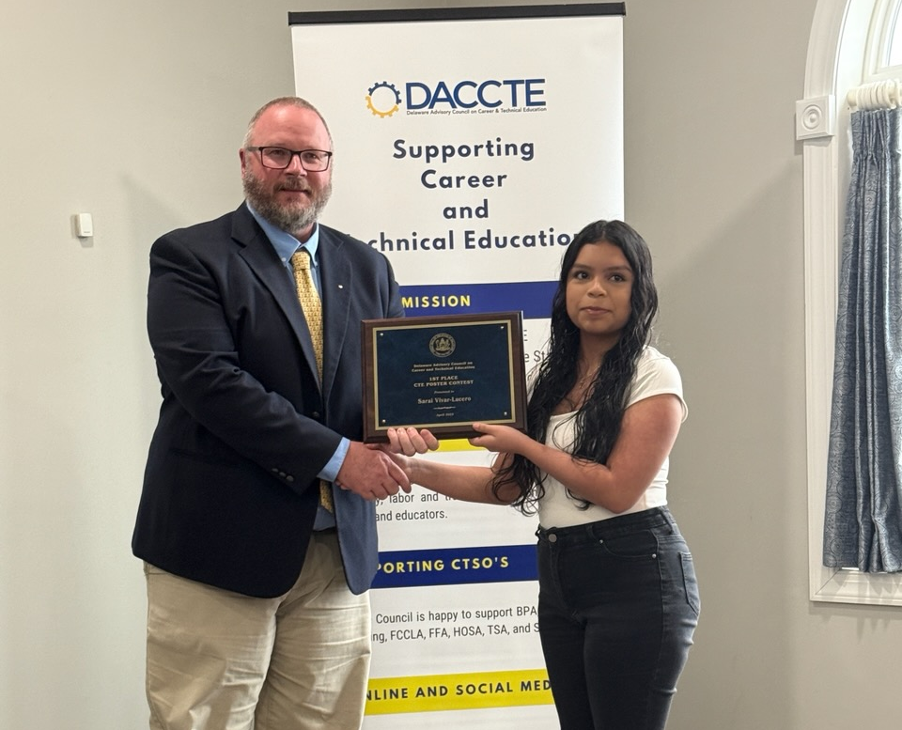
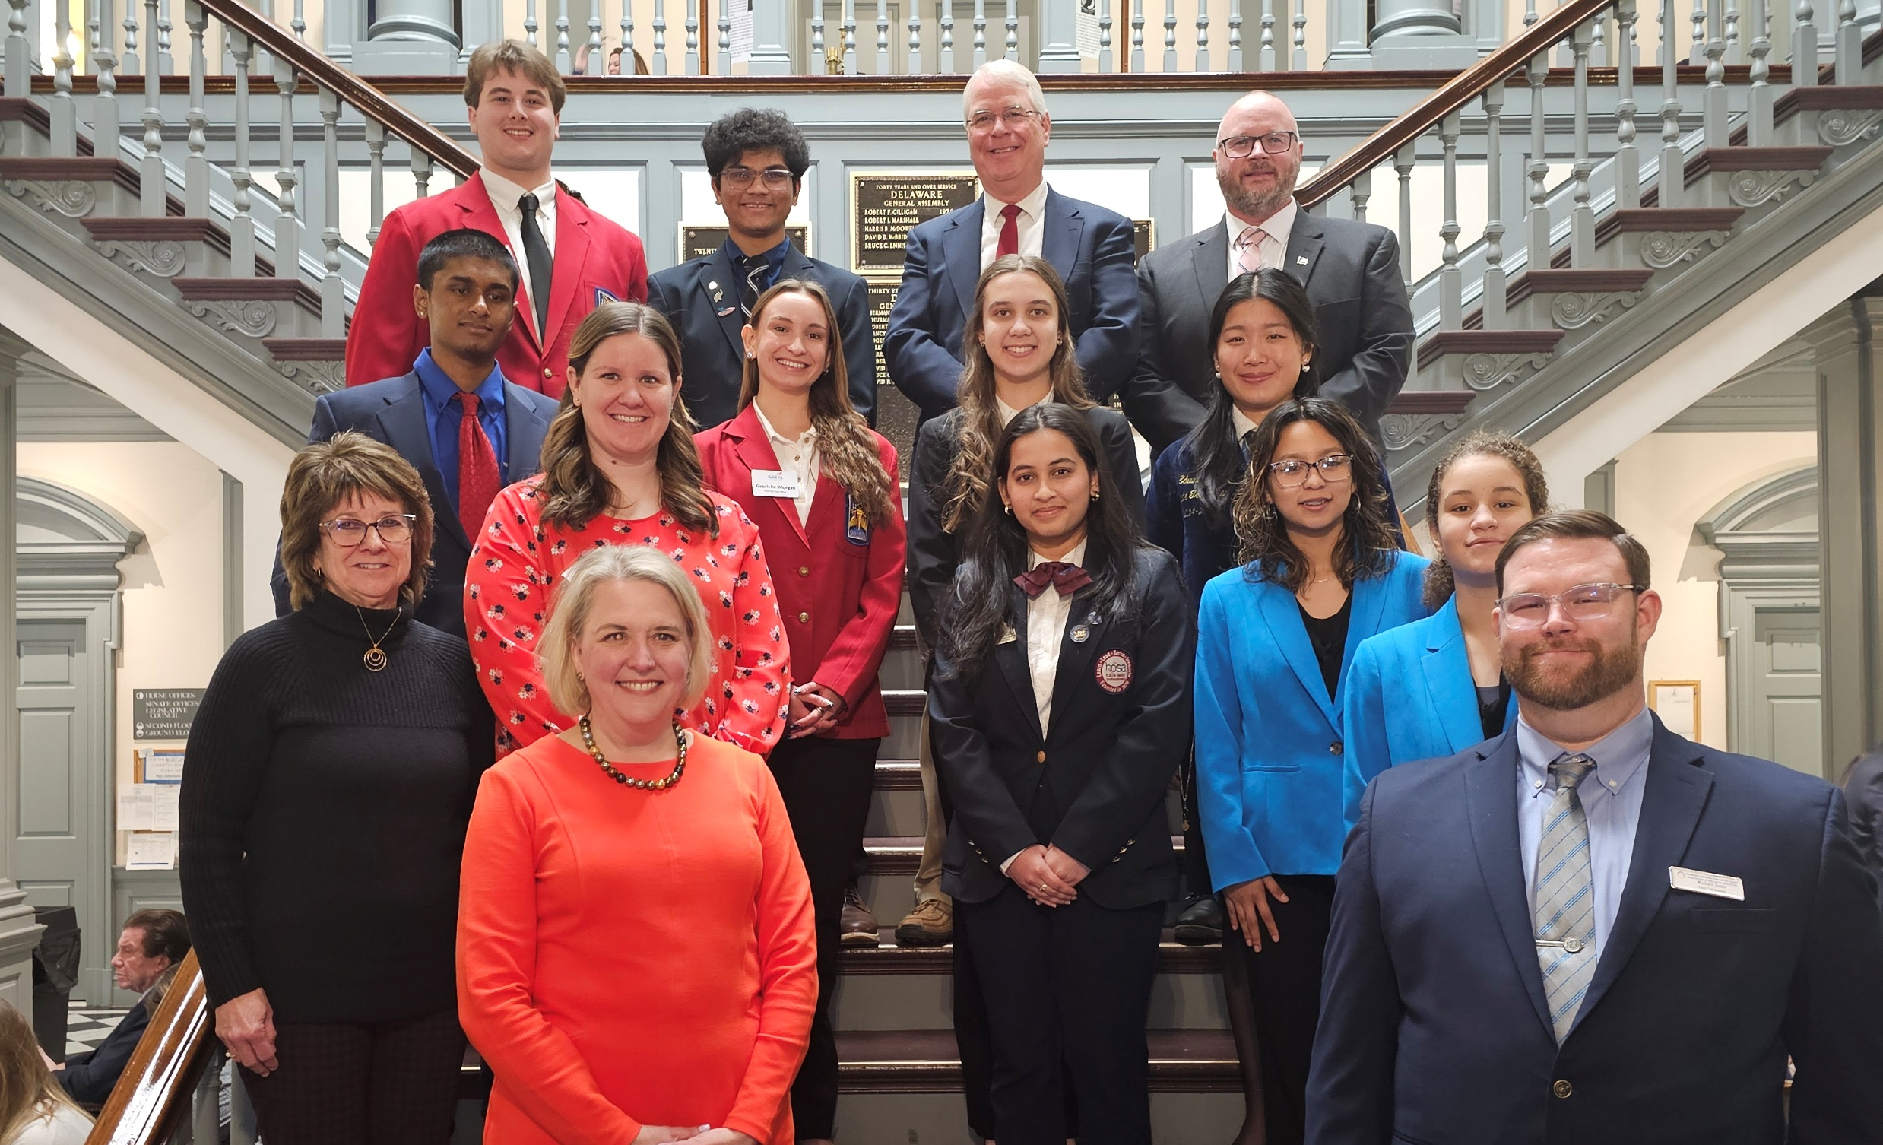
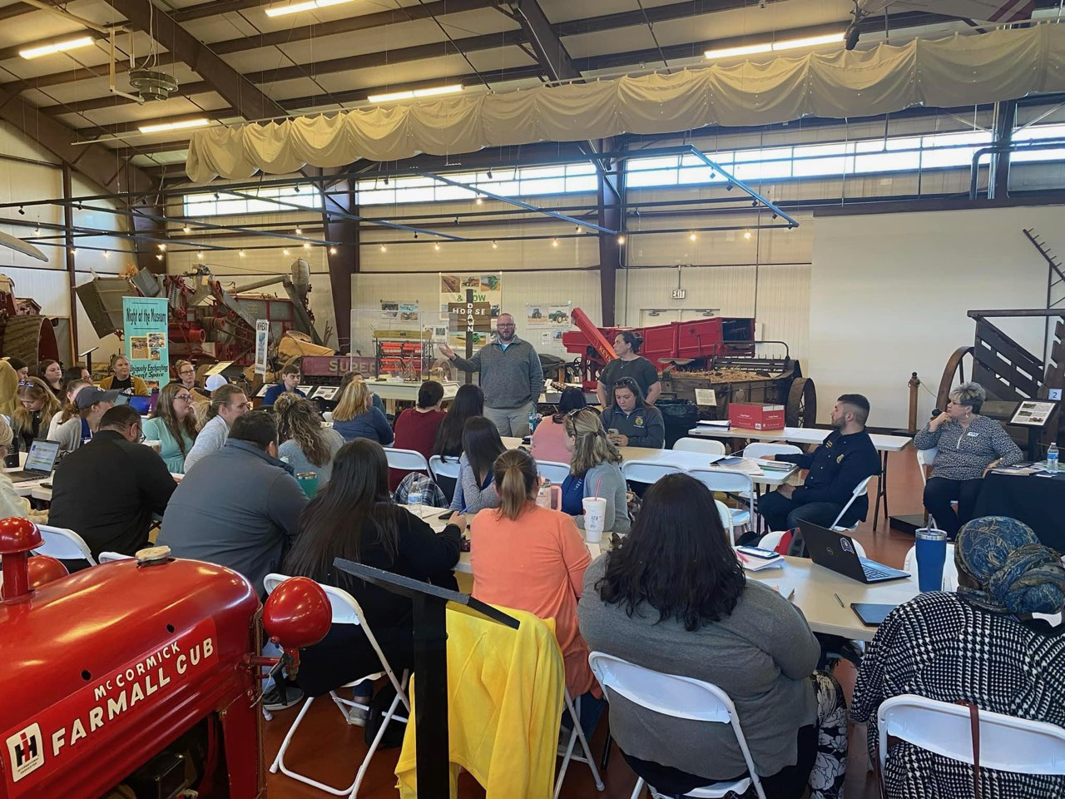
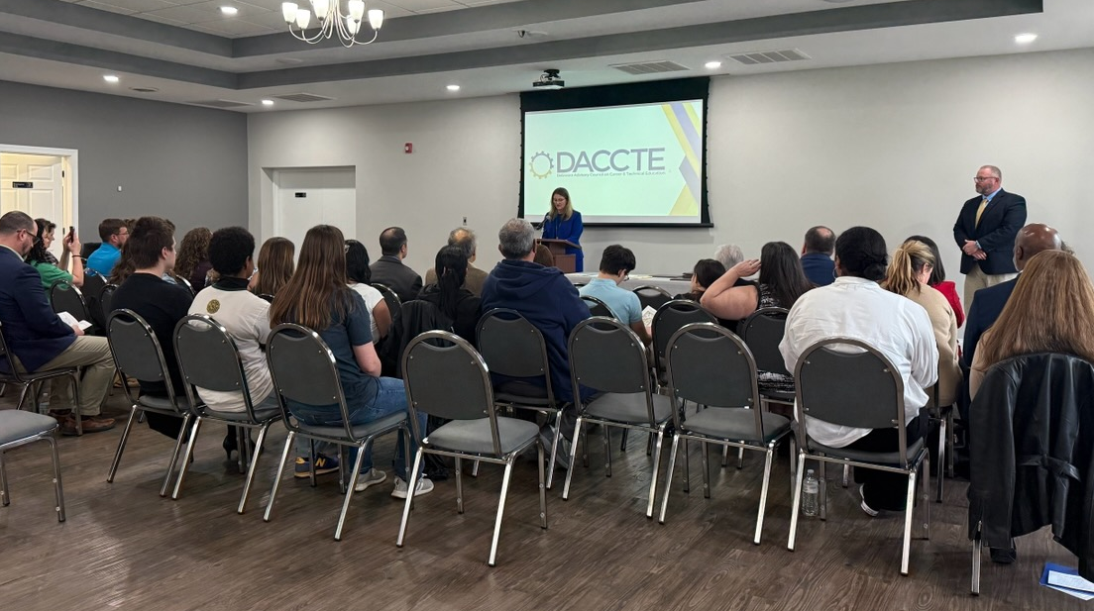
DACCTE Out and About!

Slide 8
When does DACCTE meet? When does DACCTE visit schools?
DACCTE holds 4 Council meetings per year. Council meetings are held in each county. Council meeting dates and times are posted on the DACCTE website and the public meeting page for the State of Delaware.
Meetings are generally held in March/April, June, October, and December.
School visits are scheduled on a 2-year rotation of career and technical education programs in our State during the Fall and Spring semesters. Visits consist of a DACCTE staff member, Council member, and a DOE CTE Associate.

Slide 9
Contact DACCTE
Mailing Address | Jesse S. Cooper Building Suite 143 417 Federal Street Dover, DE 19901
Website | www.daccte.delaware.gov
Phone | 302-744-4982
Executive Director Email | christopher.stahl@delaware.gov
CTE Specialist Email | caitlin.rozell@delaware.gov
Administrative Assistant Email | ann.breeding@delaware.gov

Slide 10
Moving Forward
DACCTE will be an advocate for all CTE programs in the State.
Educational program visits will be occurring at Middle and High Schools (Comprehensive and Technical).
Program Questionnaire has been turned into a survey. All teachers within a program will receive it.
Program visits will be scheduled for in person. (Virtual visits will take place if required.)
Get to know your program visits! (Local advisory meetings, unofficial visits, etc.)
Professional Development!
Career Fairs!

